Slide 1
ARRAYS

Slide 2
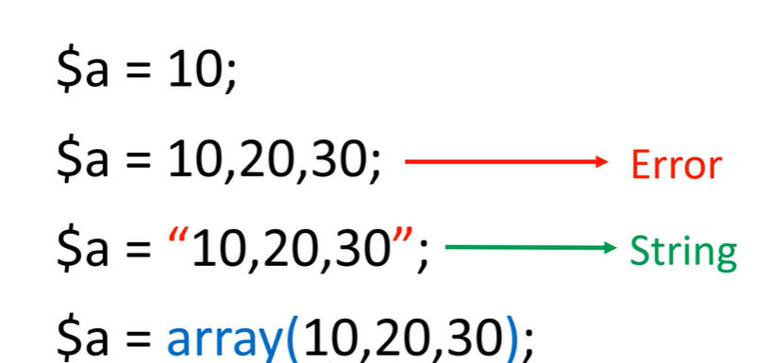
An array stores multiple values in one single variable:

Slide 3
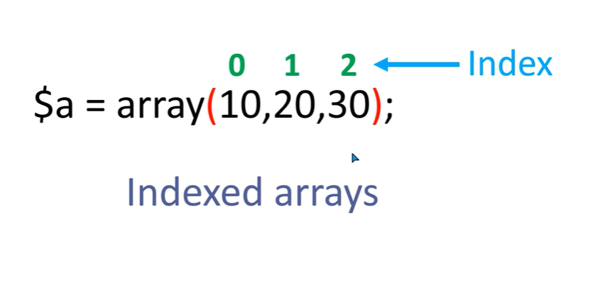

Slide 4
<?php
$colors=array("red","yellow","blue","green");
echo $colors[0]."<br>";
echo $colors[1];
echo $colors[2];
echo $colors[3];
?>

Slide 5
<?php
$colors=["red","yellow","blue","green"];
for($i=0;$i<4;$i++)
echo $colors[$i];
?>

Slide 6
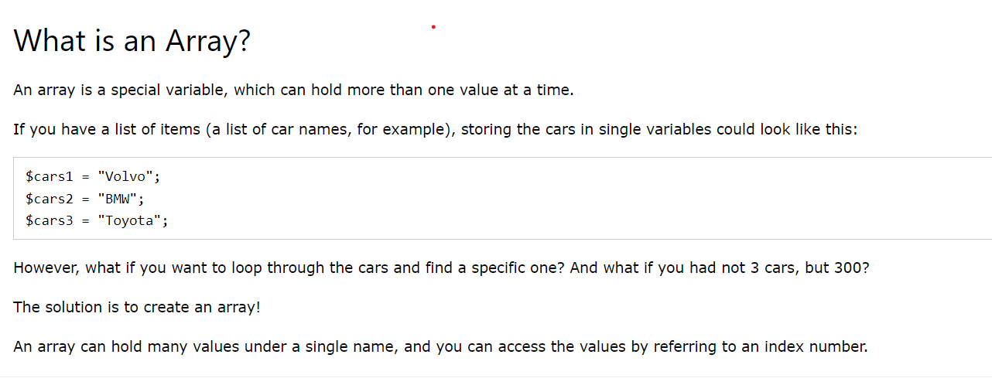
An array stores multiple values in one single variable:

Slide 7
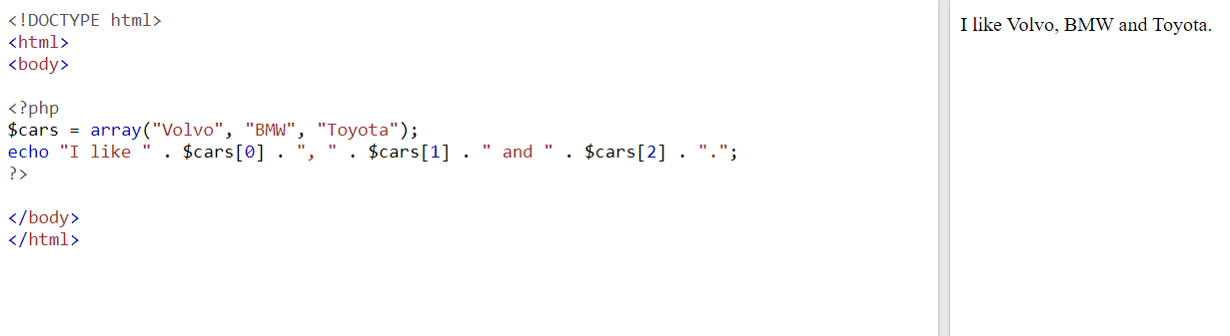

Slide 8
TRY THIS
$color = array('white', 'green', 'red'') Write a PHP script which will display the colors in the following way :
Output : white, green, red,
$color = array('white', 'green', 'red', 'blue', 'black');
Write a script which will display the following string
"The memory of that scene for me is like a frame of film forever frozen at that moment: the red carpet, the green lawn, the white house, the leaden sky. The new president and his first lady. - Richard M. Nixon" and the words 'red', 'green' and 'white' will come from $color.

Slide 9
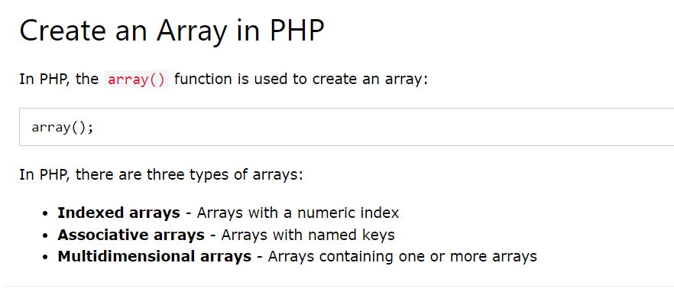

Slide 10
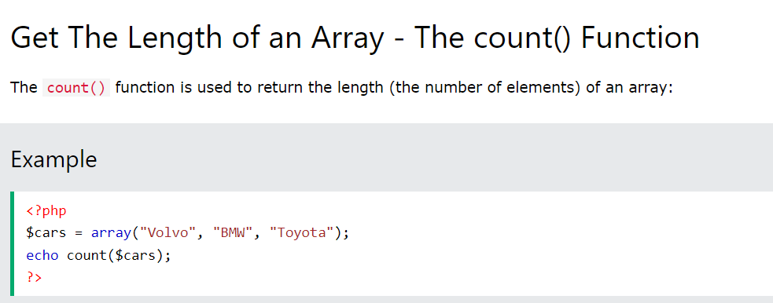

Slide 11
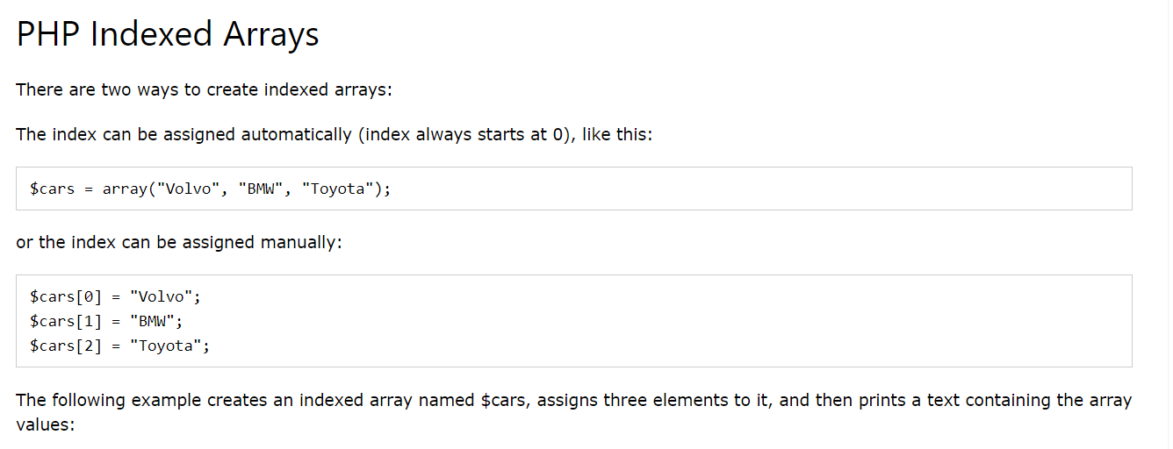

Slide 12
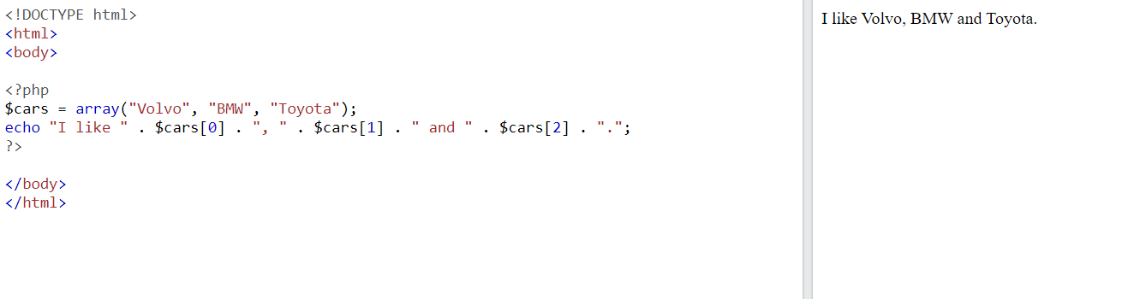

Slide 13
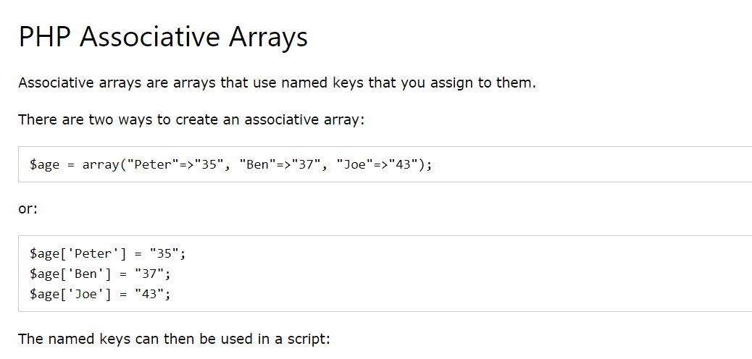

Slide 14
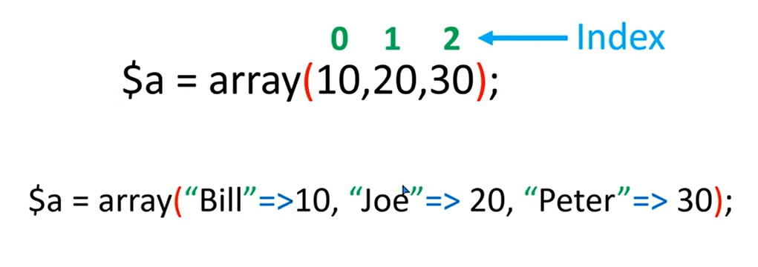
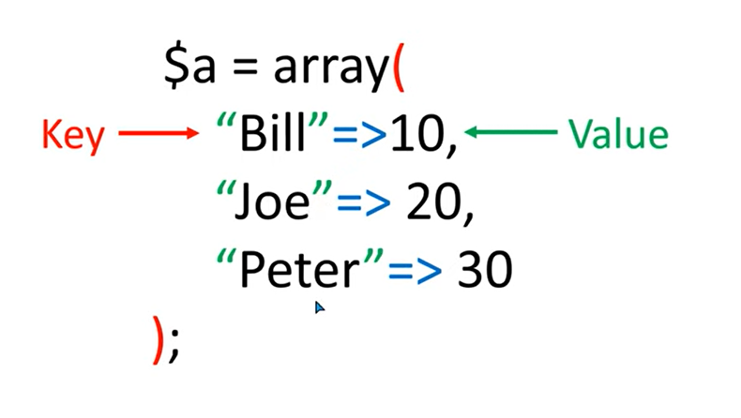
Associative Array

Slide 15
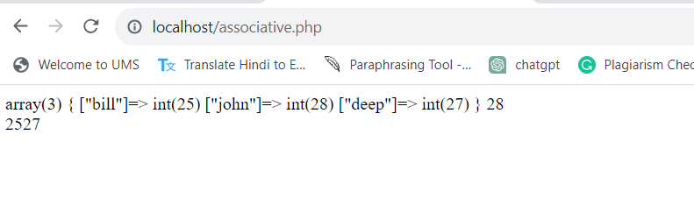
<?php
$age=array("bill"=>25, "john"=>28, "deep"=>27);
var_dump($age);
echo $age["john"]."<br>";
echo $age["bill"];
echo $age["deep"];
?>
Shows the data types of values

Slide 16
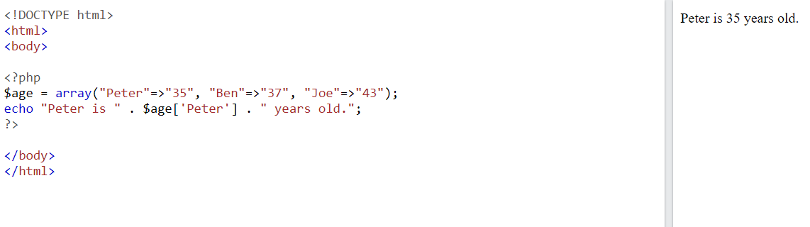

Slide 17
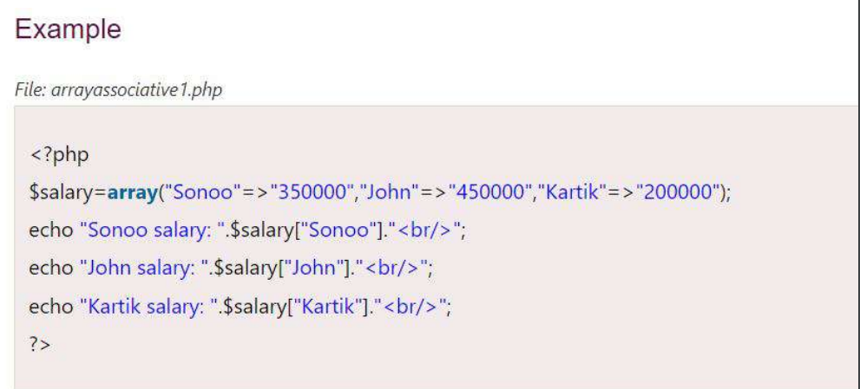

Slide 18
TRY THIS
Create an associative array representing a person's information, including name, age, and email.
Create an associative array of fruits and their corresponding colors. Loop through the array and print out each fruit and its color.

Slide 19
Loop Through an Associative Array
To loop through and print all the values of an associative array, you could use a foreach loop, like this:
<?php $age = array("Peter"=>"35", "Ben"=>"37", "Joe"=>"43"); foreach($age as $x => $x_value) { echo "Key=" . $x . ", Value=" . $x_value; echo "<br>"; } ?>
Key=Peter, Value=35 Key=Ben, Value=37 Key=Joe, Value=43

Slide 20
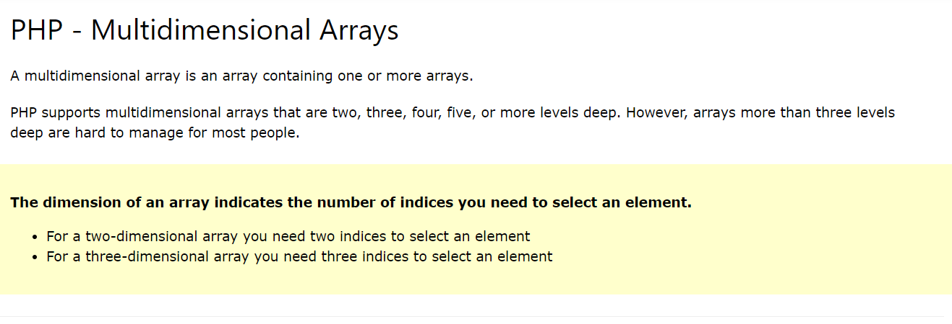

Slide 21
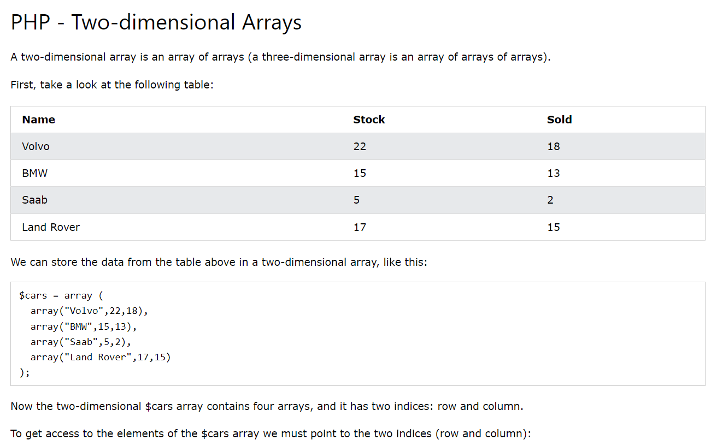

Slide 22
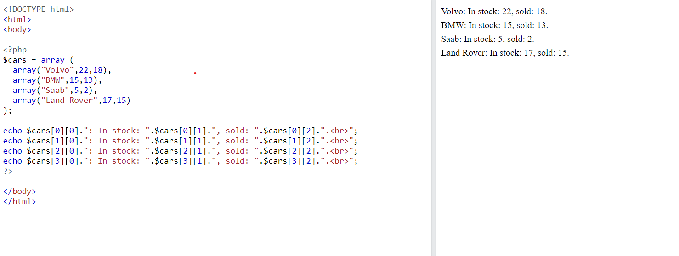

Slide 23
Write a PHP program to merge (by index) the following two arrays. Sample arrays : $array1 = array(array(77, 87), array(23, 45)); $array2 = array("w3resource", "com");
Expected Output :
Array ( [0] => Array
(
[0] => w3resource
[1] => 77
[2] => 87
)
[1] => Array
(
[0] => com
[1] => 23
[2] => 45
)
)

Slide 24
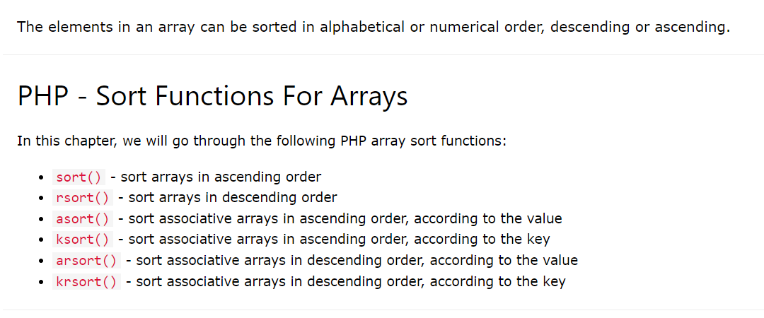

Slide 25
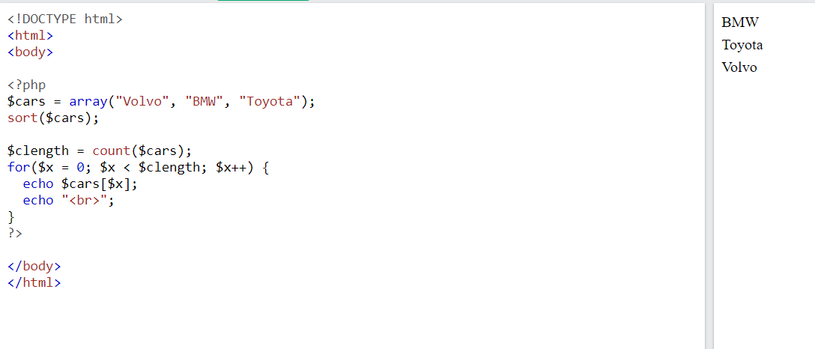
Sort Array in Ascending Order - sort()
The following example sorts the elements of the $cars array in ascending alphabetical order:

Slide 26
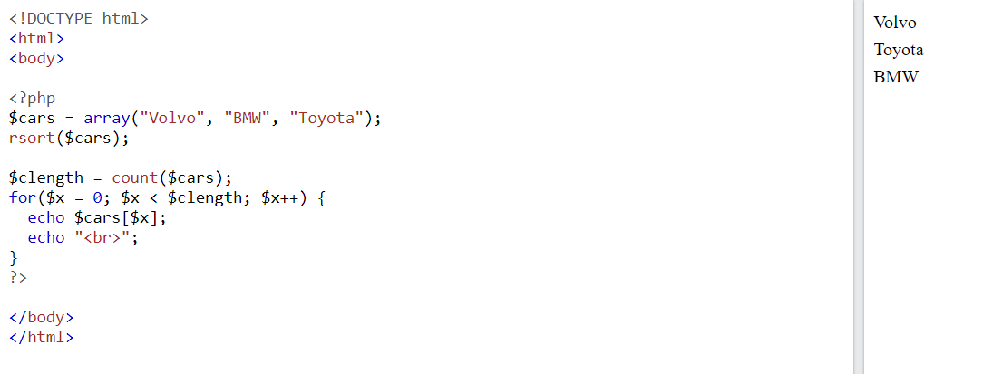
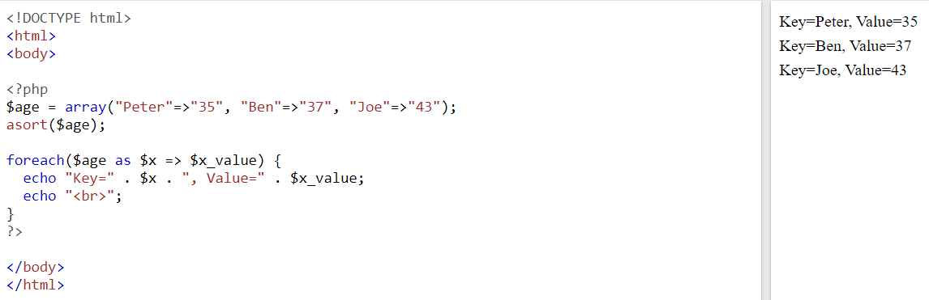
Sort Array in Descending Order - rsort()
Sort Array (Ascending Order), According to Value - asort()

Slide 27
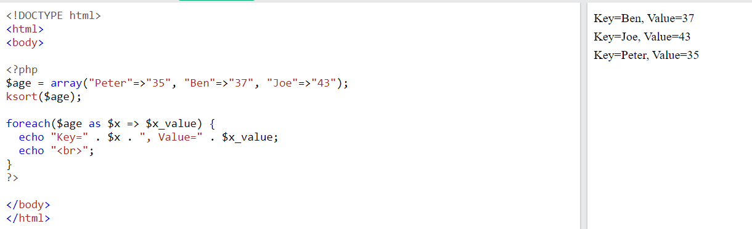
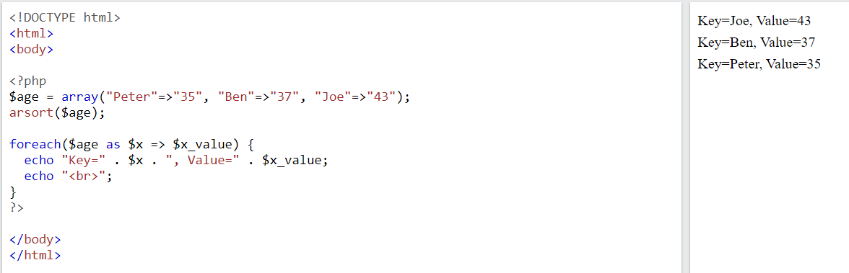
Sort Array (Ascending Order), According to Key - ksort()
Sort Array (Descending Order), According to Value - arsort()

Slide 28
TRY THIS
Write a PHP program to sort a multi-dimensional array set by a specific key.
Write a PHP function to sort an array according to another array acting as a priority list.
Write a PHP script to sort the following associative array : array("Sophia"=>"31","Jacob"=>"41","William"=>"39","Ramesh"=>"40") in
a) ascending order sort by value b) ascending order sort by Key c) descending order sorting by Value d) descending order sorting by Key

Slide 29
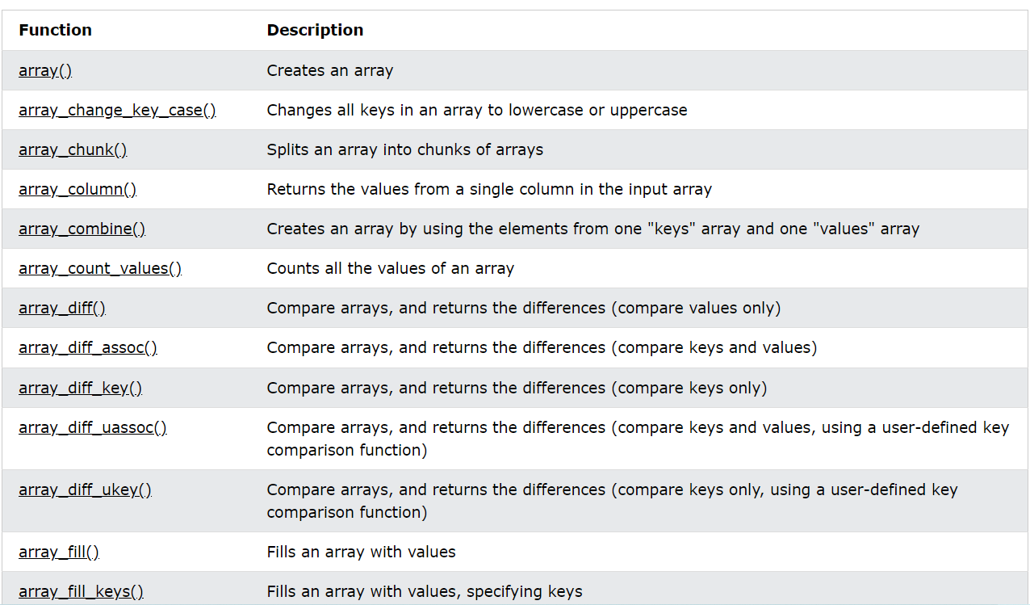
PHP Array Functions
The array functions allow you to access and manipulate arrays.

Slide 30
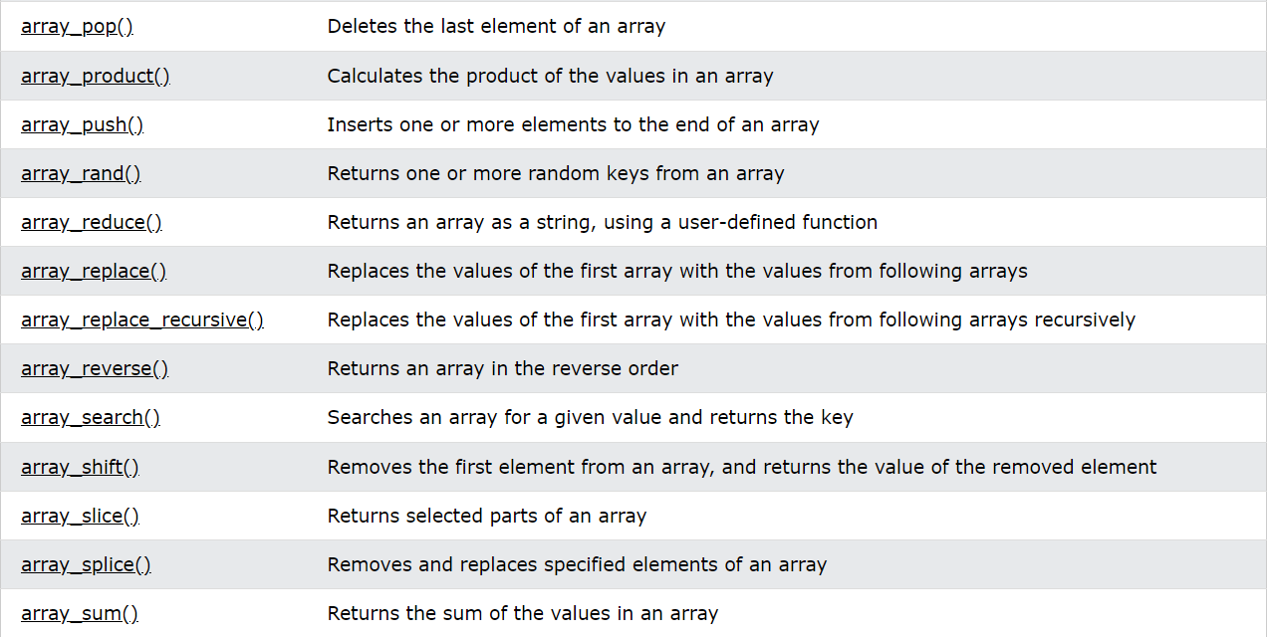
PHP Array Functions

Slide 31
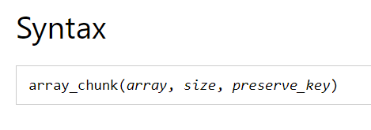
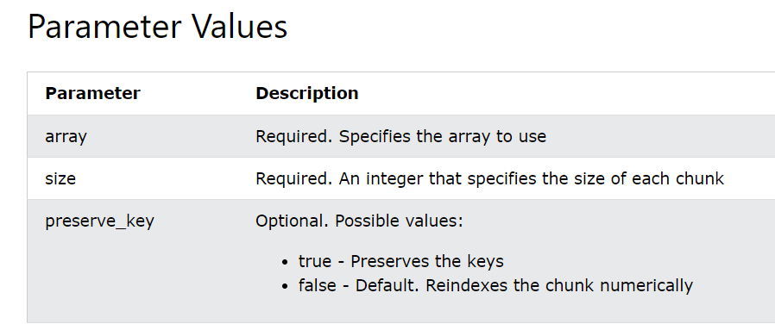
PHP Array Functions
PHP array_chunk() Function
The array_chunk() function splits an array into chunks of new arrays.

Slide 32
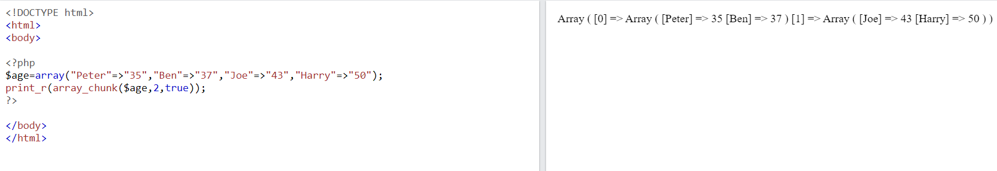
PHP Array Functions

Slide 33
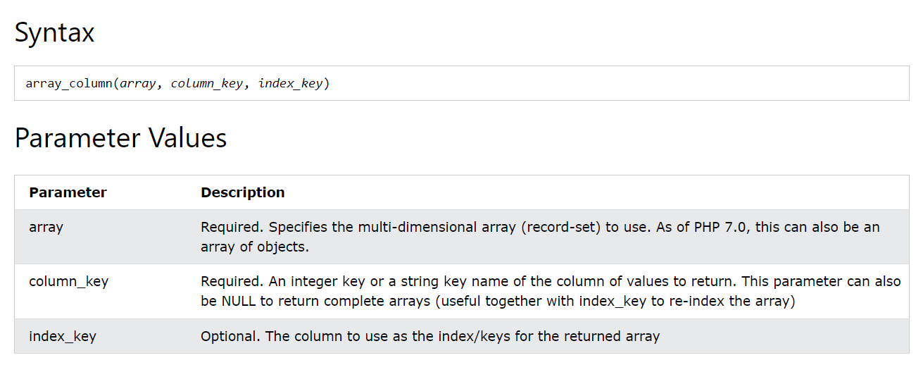
PHP Array Functions
PHP array_column() Function
The array_column() function returns the values from a single column in the input array.

Slide 34
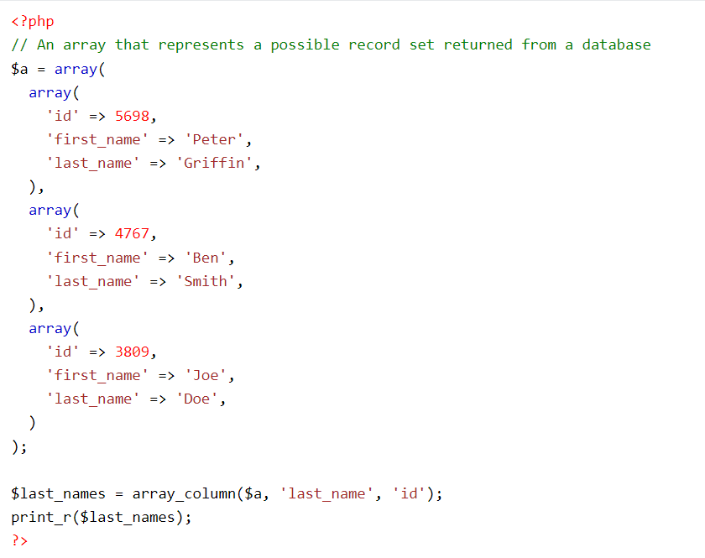
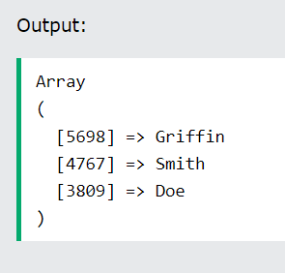

Slide 35
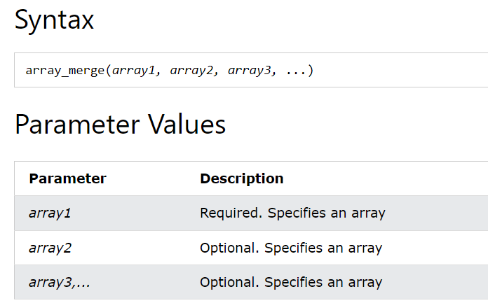
PHP array_merge() Function
The array_merge() function merges one or more arrays into one array.

Slide 36
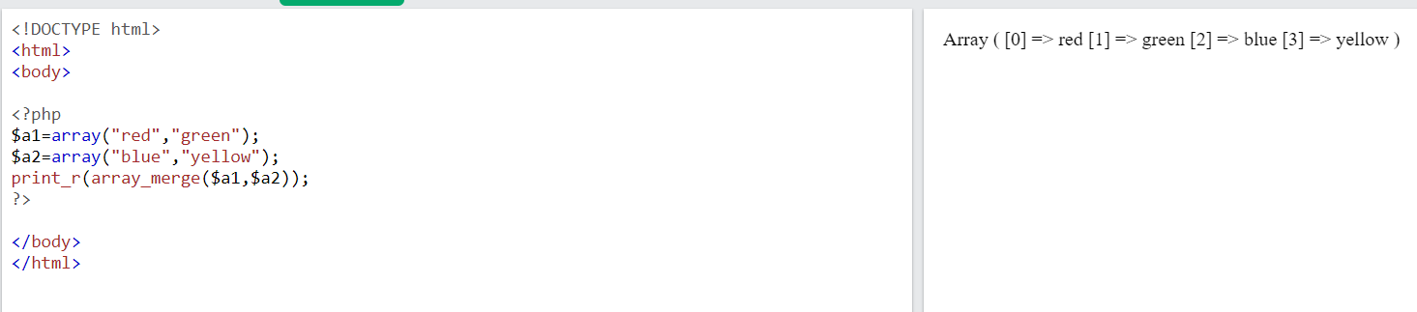

Slide 37
Traversing Arrays
Traverse an array means to access each element (item) stored in the array so that the data can be checked or used as part of a process.
To visit each and every element of an array is known as traversing array

Slide 38
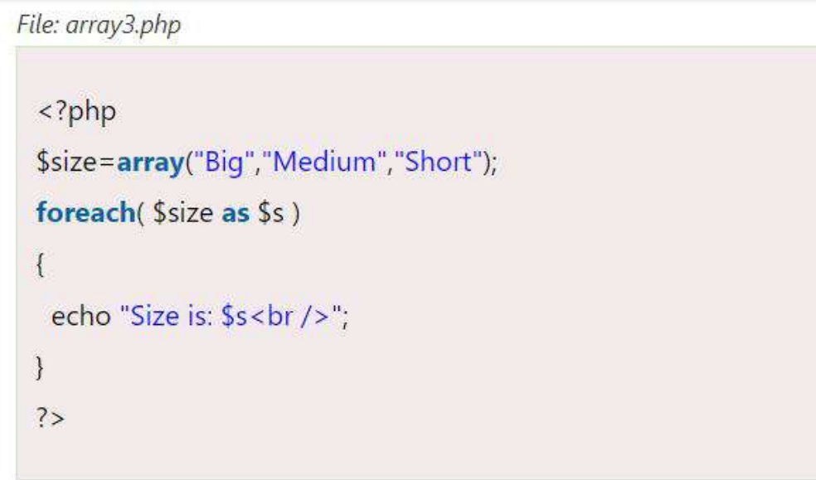

Slide 39
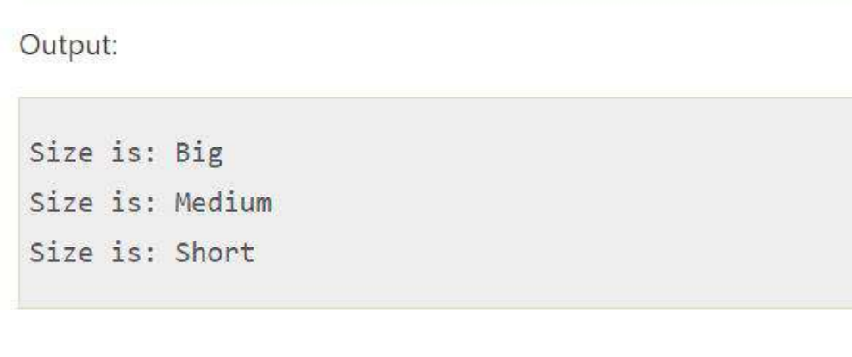

Slide 40
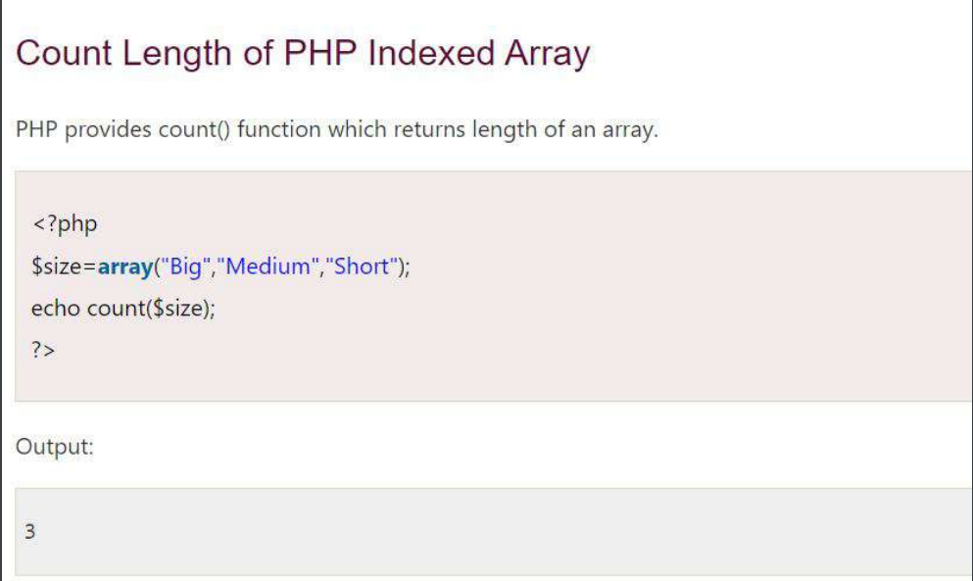

Slide 41
